Slide 1

Flip-Mart Retail Sales Analytics & Profitability Study
Business Intelligence Case Analysis
Garv Dudy
Data Analytics Project Fall 2025

Slide 2
Executive Summary
This Project analyzes Flip-Marts retail performance using 50K + transactions records
Power BI was used to build an interactive dashboard focusing on profitability , customer segments, product performance and Regional insights.
The Analysis identifies key growth regions and their countries, loss-making products, profit-driving categories, best preforming Sub-category and flow of Profit & Sales.
Findings are used to provide strategic business recommendations to improve profit and optimize operations.

Slide 3
Business Problem / Objective
Business Questions
  Which categories, sub-categories, and products generate the most sales and profit, and which are underperforming?
  How have sales and profit changed over time, and which years and regions perform best or worst?
  What is the overall profit margin, and how does quantity sold relate to profitability?
Objectives
  Identify top and bottom preforming products and regions.
  Analyze growth trends to support strategic decisions.
  Detect loss-making areas to optimize profit and business efficiency.

Slide 4
Methodology / Data Source
Methodology
  Data Cleaning and preparation in Power Querry (handled missing values/rows/columns, duplicates, irrelevant columns & data types)
  Built interactive Power BI Dashboard with different charts (bar, line, pie, area), maps, cards slicer & tables
  Applied analytical thinking to explore trends, compare profitability and identify insights.
  Focused on product performance, regional trends, yearly growth, and profit analysis.
Data Source
  Flip-Mart sales dataset excel sheet(50,000+ records) containing order details, products info, sales, profit, and many more.

Slide 5
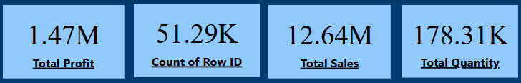
Key Performance Indicators (KPIs)
KPIs Story
  Total Sales: Flip-Mart generated $12.64M in revenue from 51,290 orders.
  Total Profit: The Business earned $1.47M, resulting in a profit margin of 11.63%.
  Total Quantity Sold: Customers purchased 178K items, averaging 3-4 items per order.
  Average Order: Each order brought in roughly $246 in sales and $28.66 in profit.

Slide 6
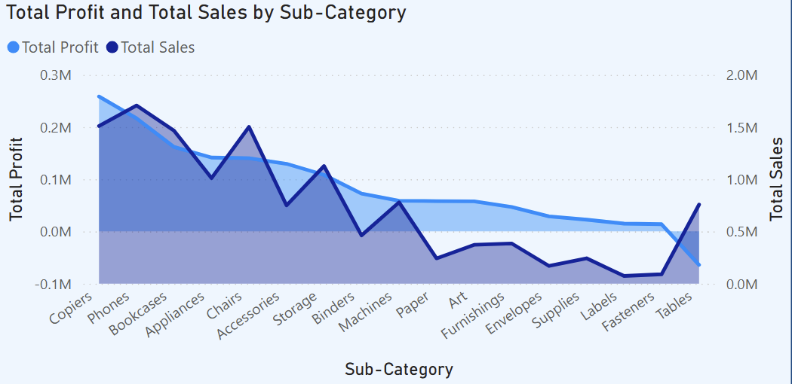
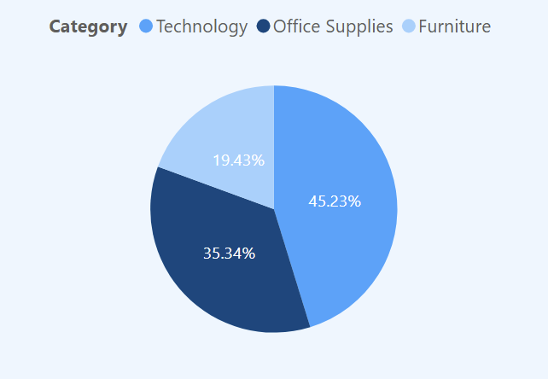
Sales & Profit Distribution by Category & Sub-Category
Phones generates high sales & their profit trend follows the same growth (high-profit : high-sales).
Copiers have the high profit among all sub-categories.
Chairs & Storage shows consistent profitability
Tables are the biggest loos-maker (high sales volume but -64K profit)
Technology is out main profit driver – almost half of total profits came from this category
Furniture contributes the least – making it a low priority category for growth focus
Office-Supplies performs as a stable middle-tier category

Slide 7
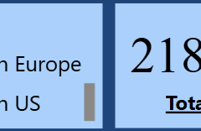
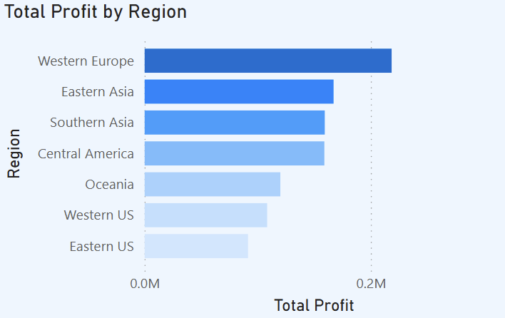
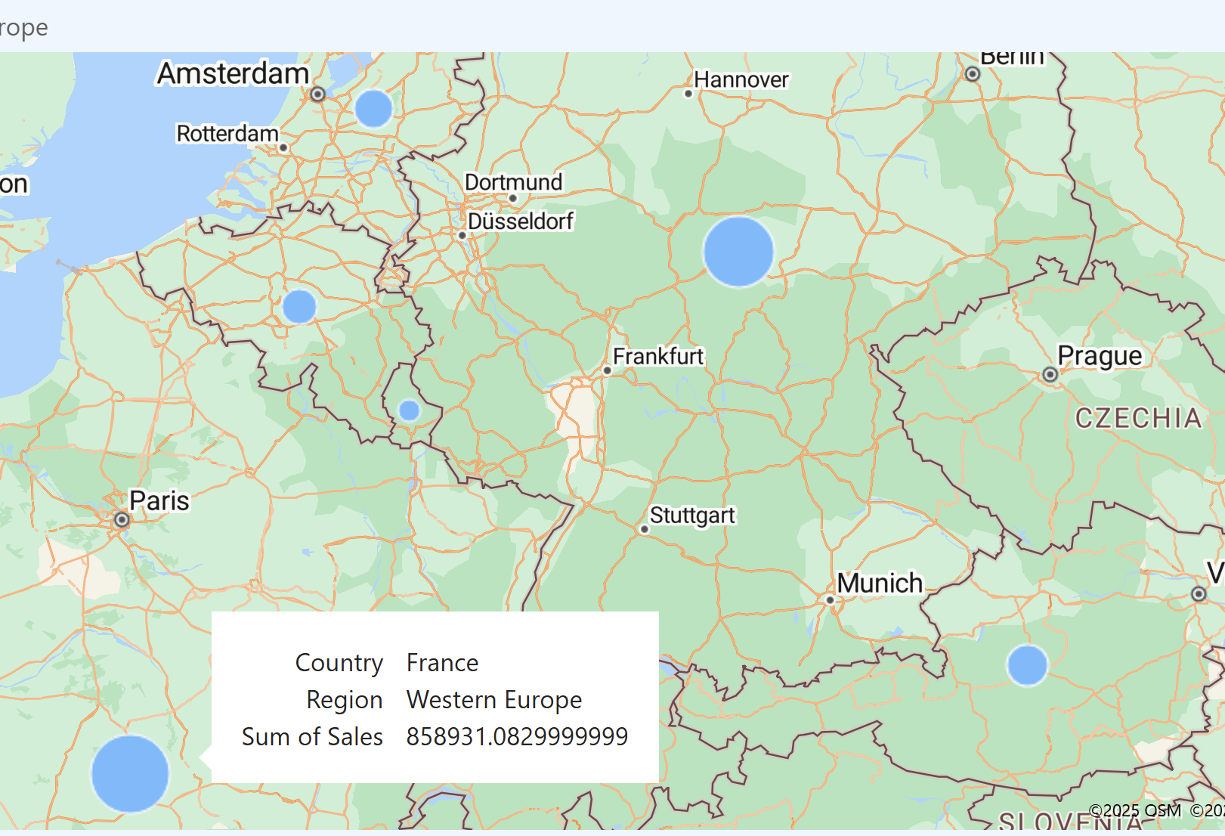
Regional Profit Performance
Western Europe leads the company with $218k in profit, while Southern Asia is close behind with 159k – both are high priority growth regions.
Western Africa and Western Asia are loss-making markets (-50k to -54k) these region require pricing and strategy correction.
Southern Europe, Sothern US & Western US generates moderate returns – stable regions that can be optimized further to incremental growth.

Slide 8
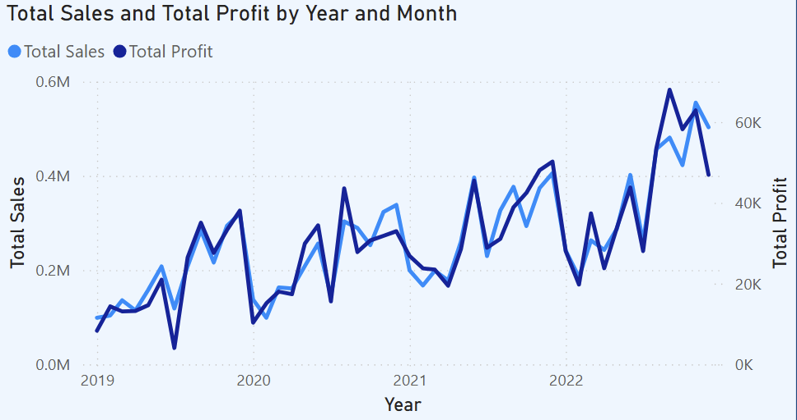
Sales & Profit Trend Over Time
From Jan-2019 to Dec-2019 (pre-pandemic period) sales showed a strong expansion curve – with an average Monthly Growth Rate of ~14.8%. This early ramp-up built a very strong baseline before COVID disruption hit.
Sales & profit declined during the core pandemic period (Jan-2020 to Mar-2021), with only two temporary rebounds in June-2020 and Aug-2020.
A strong recovery and momentum phase is visible from May-2021 to Dec-2021, driven by consumer demand normalization.
2022 begins with a contraction (Jan-2022 to Aug-2022), likely due to inflation effects & delayed purchasing behavior.
Profit peaks in September 2022 (~68K) – strongest monthly profitability across the entire timeline.
Highest sales volume occurs in November 2022 (~555K+), aligned with seasonal peak buying period (per-holiday cycle).

Slide 9
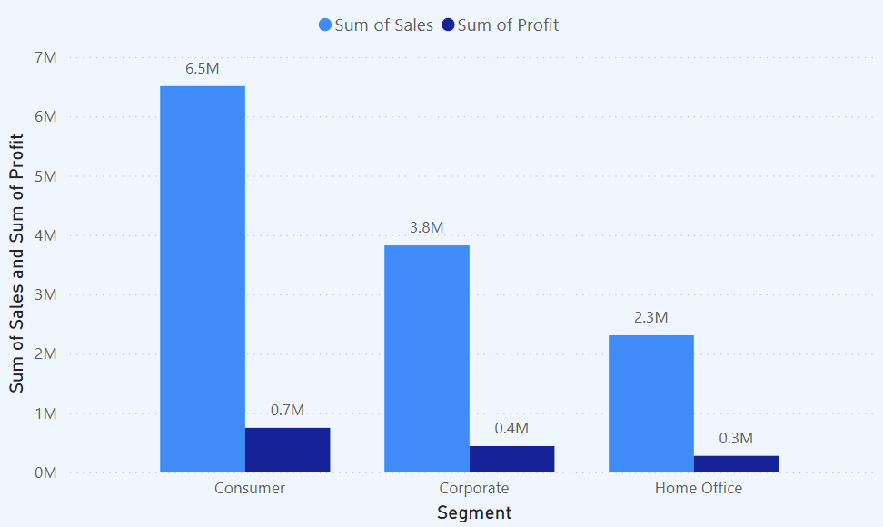
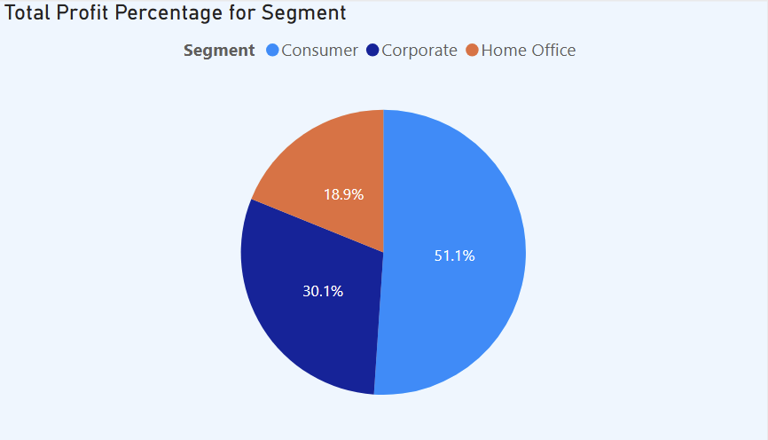
Customer Segment Insight
Customer segment is the primary revenue driver, contributing 51% of total profit ($0.75M) and 51% of total sales ($6.5M) – strongest customer base
Corporate segment delivers stable profitability at 30% share ($0.40M profit) on ~$3.8M sales, showing strong business-to-business demand.
Home Office is the smallest segment, generating 19% of profit ($0.30M) from $2.3M sales – presents moderate opportunity, but not a core driver.

Slide 10
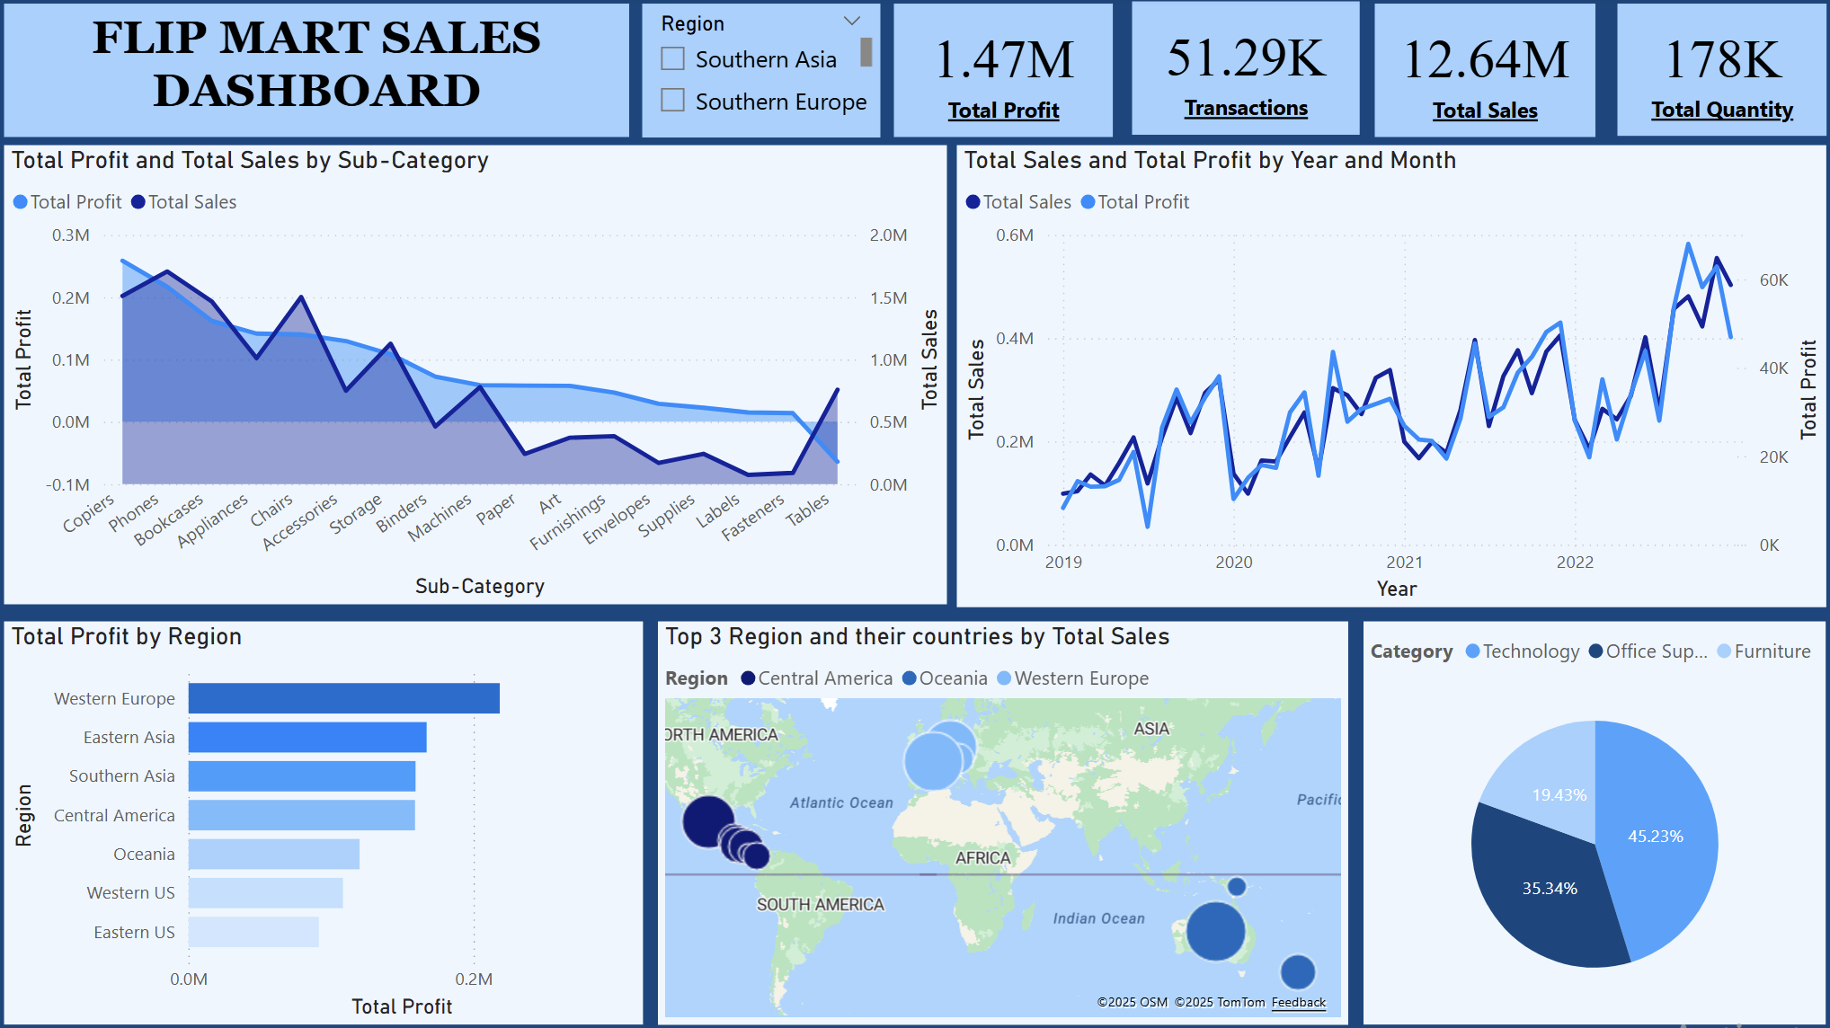
Overall Region, Category & Time-based Performance Dashboard

Slide 11
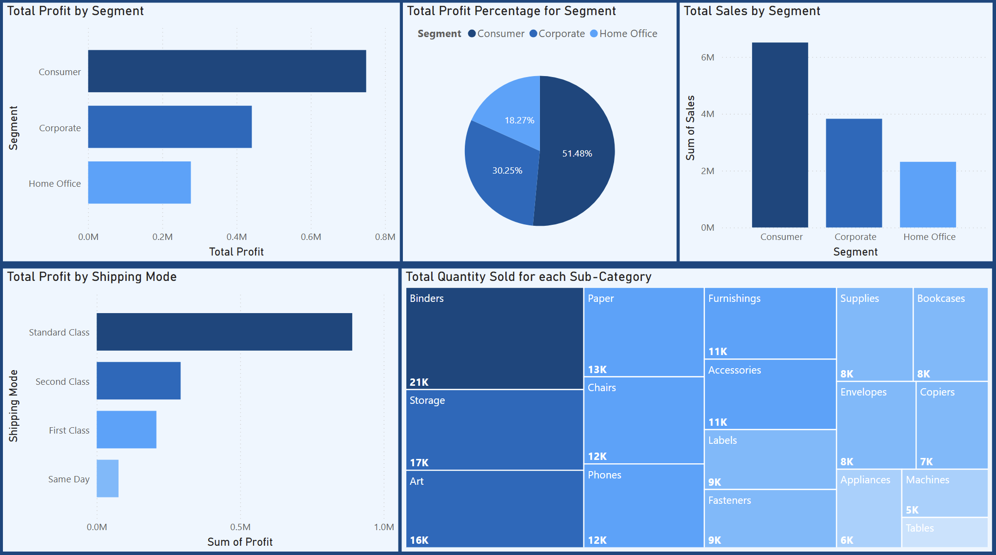
Customer Segment & Shipping Mode Profitability Dashboard

Slide 12
Key Findings & Strategic Recommendations
Focus regionally action > especially Western Africa + Western Asia. Use bundling + cross selling: phones + appliances Or phones + binder deal > example: “Buy Phone > get 30% off Binder Or “Buy Phone > Storage free for first month (max limit)”. Start small – track margin > scale only if profit turns positive.
Standard class holds the highest volume but does not give best profitability. First class + second class shows better profit ratio per shipment. Strategy – run a limited time upgrade scheme: “Pay Standard – Auto upgrade to first class for next 3 orders”. This increase the habit of using better margin shipping – without dropping base price.
Customer segment contributes the highest – both profit & sales – so keep standard strategy same here. But home office is underperforming – very low participation. Best approach is to connect home office with corporate bundles: “Corporate annual contract – include 1 home office user plan free for 90 days”. This increase home office activation – without major marketing spend.
Western Europe & Eastern US are the only 2 region where tables are deep negative. Stop Table-focused promotion in these 2 regions temporarily & only taking pre orders or on demand with little over prices to maintain the profit will be best practice with this strategy of making them like ”Buy 2 get 1 free”.
Final Thought: Instead of pushing all products everywhere, we should reduce stock for negative-margin products in loss-making regions and redirect those same products toward regions where the product already preforms positively. Using this we can protect profit while keeping sales moving.

Slide 13
Conclusion
Profitability is uneven across regions – Western Europe & southern Asia are the strongest levers
Phones & Copiers are proven margin-drivers -> focus future promotion here
Tables & western Africa are bleeding money -> immediate cost control needed
Skills
  Analytical thinking & Problem-solving
  Data interpretation & insight generation
  Trend analysis & performance evaluation
  Visualization best practice
Tools
  Power BI – Dashboard creation
  Power Query Editor – Data Preparation, shaping, Data Cleaning and Transformation
Copyright Garv Dudy Nov 2025

